Slide 1
Final Joint Presentation Hi-fi (UXID) & Android App (COMT) Demo Moosic
Isaac Tan
2100902B
P11
Cybersecurity and Digital Forensics

Slide 2
1. Mobile App Value Positioning Statement
Mobile App Value Positioning Statement
For | Frequent music listeners
Who | Want to have a simpler music app design/layout
The | Moosic | is a | Music app
That | Satisfies the users by using a very basic and simple music app
Notes:
* Sample (For reference only)
For non-tech-savvy movie lovers
who want to check out on movies and their reviews.
The “XYZ Movie Review” is a mobile-based movie info solution
that enables the movie lovers to have an avenue to discover movies.

Slide 3
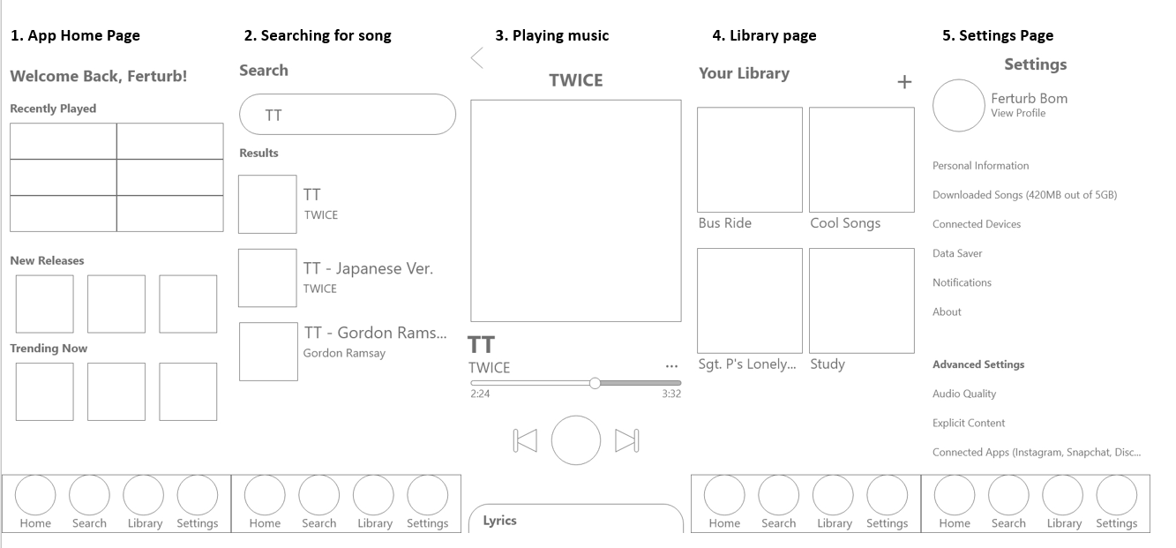
2. Low Fidelity Vs High Fidelity Prototype Low Fidelity:

Slide 4
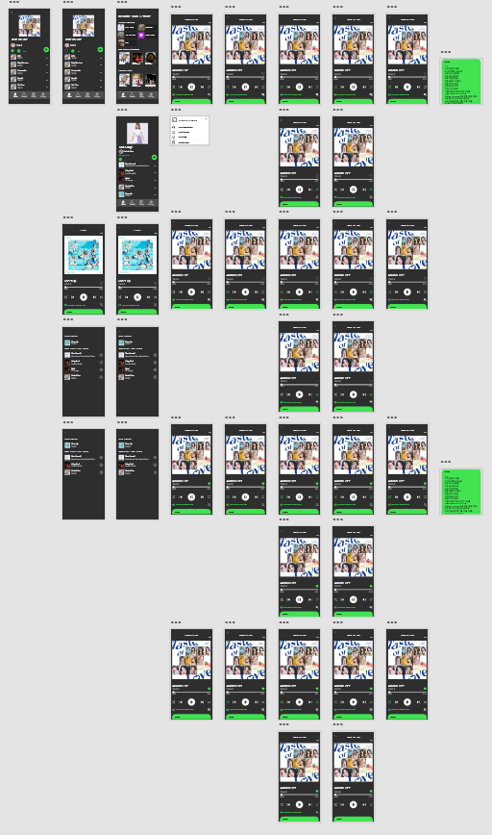
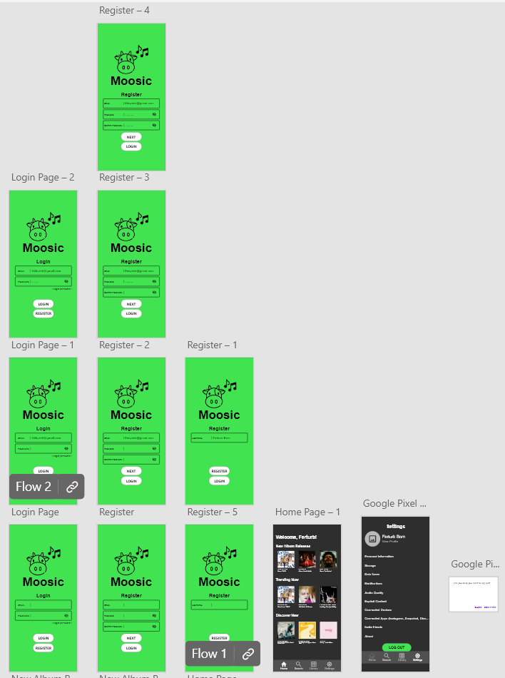
2. Low Fidelity Vs High Fidelity Prototype High Fidelity:
PREVIEW LINK:
https://xd.adobe.com/view/1a208697-eed7-4b7b-b6b7-0f093c7023ff-4f73/?fullscreen&hints=off

Slide 5
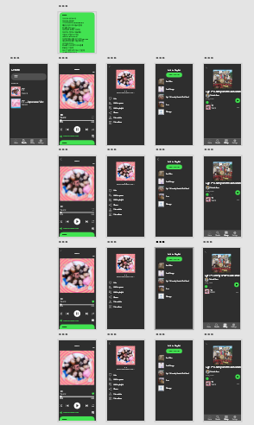
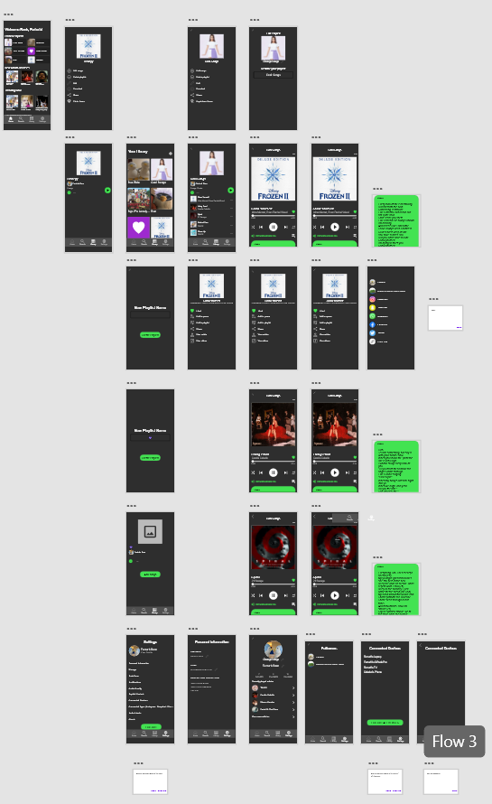
2. Low Fidelity Vs High Fidelity Prototype High Fidelity:

Slide 6

3. Video Demo of Hi-Fi Prototype
https://youtu.be/UJxNIBD4uHw

Slide 7
4. Video Demo of Music App
https://youtu.be/xYJYrz0CrxE

Slide 8
5. Personal Reflection
The experience doing this project was very fruitful and enriching.
Being a student not having any coding background and very new to coding, I managed to get a hold of what I am coding after many weeks of attending lectures and asking questions. Also, as a student that has no designing background and does not like to design things, learning about designing was more fulfilling rather than to design as I got to know the behind the scenes of the designing part as I have not realised about them even when I use these apps every day.
I really enjoy the coding part of this assignment. Starting from literally just a blank page and after many weeks of progress, the end result of the app working is very satisfying. The designing may be a little troublesome as there were many small details that matters to the whole project, but now looking back at the low fidelity prototype, I am very proud that this project works very successfully.
I rate the experience for this whole assignment as a 5 ☺

Slide 9
Thank You !

